Slide 1

Windows PowerShell
System administration and automation in a Windows environment
- Scripting -
Karin De Maertelaere, Jochen Mariën

Slide 2
Scripting
So what have we been doing until now?
Writing commands, not writing scripts
You can extend PowerShell, and use it as a ‘real’ programming language
Try to stop before going too far
You can tune your scripts to be easily useable by coworkers

Slide 3
Comment
# comment
<# A block of comments, you can type continuously. Special characters ( #, $, {, }, &,<,>, …) may be included. #>

Slide 4
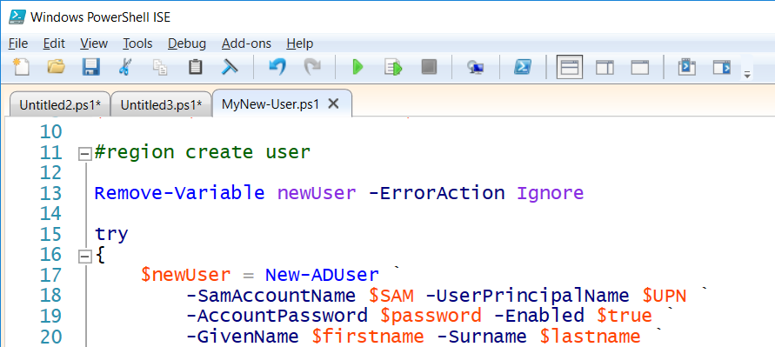
Region
A region is a part of the script that belongs together
Putting it in a region makes it possible to “click it together” in the ISE
Regions have no effect on the code execution
#region create user
Remove-Variable...
#endregion
Notes:
https://blogs.technet.microsoft.com/heyscriptingguy/2015/11/12/use-regions-in-powershell-ise-2/

Slide 5
Newlines
There are two ways to have a command-string continue on the next line
Backtick
Piping
Backtick: ` (AltGr + µ)
To separate parameters
Piping: | (AltGr + &)
When cmdlets are piped together, you can start a newline with every | without the backtick
New-ADUser `
-name "Morgan Freeman" `
-Path $location `
-samAccountName "Morgan.Freeman" `
-AccountPassword $password `
-PasswordNeverExpires $true `
-Enabled $true

Slide 6
Variables
$variableName
Consist of letters, numbers and _
Implicit declaration by assigning a value
Data: all types of data, including objects
Type: may but does not need to be explicitly defined
.Net class names and type names
[System.int32] (.Net)
[int] (PS) (type accelerator)
[int32] (shortcut for the .NET class type)
Type in front: [int] $a, will accept only data of that type

Slide 7
Variable types
$a = 5 # a will become the most suitable datatype
$a = [int] 5 # a will become an integer
$a = [int] 5.6 # a will become 6
Variables can change type…
When using the DateTime-type: use internal datenotation!
$a = 5
$a.GetType() # Int32
$a = 5.6
$a.GetType() # Double
$d = [System.DateTime] "12.04.1997"

Slide 8
Type accelerators
So is it [datetime] or [System.DateTime]?
It’s [System.DateTime], but [datetime] is a type accelerator
Type accelerators: shorter names for existing classes
[int] in stead of [System.Int32] (and not [System.Int64])
An overview:
function get-typeaccelerator {
# reference the accelerators
$acceleratorsType = [psobject].assembly.gettype("System.Management.Automation.TypeAccelerators")::Get
# return all built-in accelerators (property)
$acceleratorstype.GetEnumerator()
}
get-typeaccelerator

Slide 9
Datatypes
You can have the type be determined automatically
Or you can set it manually
This will stop the type from changing:
$i = 5368888888888888
[Int64] $i = 5

Slide 10
Strict mode
Forces you to declare variables
Doesn’t check:
Whether the codes works in PS2.0
That you don’t change the type of a variable
That the field you select in a table exists in the object
Corresponds with “Set-PSDebug”
Write-Host $noVar # no problem
Set-StrictMode -Version latest
Write-Host $noVar # error

Slide 11
Clearing and removing
Clearing a variable makes it empty
Removing a variable destroys it
But even after removing it, you can read the value
Unless you are using strict mode
Clear-Variable a
Get-Variable a
Remove-Variable a
Get-Variable a

Slide 12
Predefined variables
$true and $false
$args
An array containing the arguments to the script/function
$Error
Contains all errors in this session
$HOME, $PROFILE, $PSHOME, $Host, $PSVersionTable , …
Get-Variable for the others

Slide 13
Constants
A variable that can’t be changed
Nice for values that you want to define once, and reuse
$tempFolder, $domainName
Created with “Set-Variable”
Set-Variable MyConstant "ok" –Option readonly
$MyConstant
$MyConstant = "nok"
Remove-Variable MyConstant -Force

Slide 14
Automatic resolving
From “$variable” to “content of var”
Only works between double quotes
Not between single quotes
Not when it’s backticked ( ` )
Works anywhere you can use strings
As parameters…
$a = 1
Write-Host "The content of `$a is $a."
# In the parameter of a cmdlet
$proc = "powershell*"
Get-Process -Name $proc

Slide 15
Automatic resolving
Watch out with arrays…
Will return a list of all servicesnames, and “[0].name” in the end of it
Works!
Also:
$services = Get-Service
Write-Host "First servicename: $services[0].name"
Write-Host "First servicename: $($services[0].name)"
Write-Host ("First servicename: " + $services[0].name)
Notes:
Write-Host "First servicename:" $services[0].name

Slide 16
Strings
Other languages have string-functions:
Substring($string, 3,5) cuts a part out of a string
In PS, these functions are methods of the string-objects:
" " | Get-Member -MemberType method
CompareTo | PadLeft | Substring
Contains | PadRight | ToLower
EndsWith | Remove | ToUpper
Equals | Replace | Trim
IndexOf | Split | TrimEnd
Insert | StartsWith | TrimStart

Slide 17
String manipulation
$a = "A piece of text."
# Functions
$a.ToUpper()
$a.PadLeft(50)
$a.Trim()
$a.Trim("A","."," ")
# comparing
$a.Contains("piece")
$a.CompareTo("B piece of text.")
$a.CompareTo("0 piece of text.")
$a.Trim(".").ToUpper().EndsWith("TEXT")

Slide 18
String manipulation
What’s in it for me?
A good point, editing strings is a programming-thing, not a scripting-thing
But:
Import-Csv $csvfile -Delimiter ';' -Encoding UTF7 |
foreach-object { new-aduser -Path $pathInAD `
-SamAccountName $_.first.replace(' ','.') `
-UserPrincipalName $_.first.replace(' ','.') `
-DisplayName ($_.first + " " + $_.last) `
...

Slide 19
Strings: Static vs instance
Static methods
A method on the class
Use “[name class]::” when calling
Instance method
A method on an instance of the class
Use “$varname.” when calling
" " | Get-Member -Static -MemberType method
" " | Get-Member -MemberType method

Slide 20
Strings: Static vs instance
The instance methods are usually somewhat more logical
Sometimes an instance method doesn’t exist
[String]::Join
Everything from [Math] is usually used static
# the static way
if([STRING]::Equals("b","b"))
{ Write-Host "Equal" }
else
{ Write-Host "Not equal" }
$var = "b"
# the instance way
if($var.Equals("b"))
{ Write-Host "Equal" }
else
{ Write-Host "Not equal" }

Slide 21
References
Have a variable that is a reference to another variable
Always alter the reference through “.value”!
Otherwise you ‘break’ the reference
Mostly used as parameters for functions
$greeting = "hello"
$refToGreeting = [ref]$greeting
$refToGreeting
$refToGreeting.value = "Good day"
$greeting
$refToGreeting.GetType().FullName
# System. … .PSReference
$refToGreeting = "Good day"
$refToGreeting.GetType().FullName
# System.String

Slide 22
Reference parameters
function referencetest([ref]$cup, [ref]$plate)
{
$cup.Value = "coffee"
$plate.Value = "muffin"
return "Ready!"
}
$myCup = "empty"
$myPlate = "empty"
referencetest -cup ([ref]$myCup) -plate ([ref]$myPlate)
"In my cup: " + $myCup
"On my plate: " + $myPlate

Slide 23
Arrays
Any sequence of comma separated values is an array
Datatypes don’t need to be the same (but should)
You can also explicitly create an array…
And look at all the methods and properties of the array-class
$array = "one", "two", "three"
$array = 1, "two", (1/3)
$array = @(1, "two", (1/3))
$array | Get-Member # shows meths and props of elements in array
Get-Member -InputObject $array # shows meths and props of array

Slide 24
Arrays
Strongly typed array
Multi-dimensional array
Adding values
[int[]] $array = 1,2,3,(10/3),"5"
$array = @( (1,2,3),("four","five","six"),7)
$array[0] # 1, 2 and 3 (seperate lines)
$array[1][2] # six
$array[2] # 7, but very bad programming
$array = 1,2,3 # 1,2,3
$array += 4 # 1,2,3,4
$array[4] = 5 # Next index: error
$array[7] = 6 # Skipping indexes: error
$array.Add(6) # error

Slide 25
Wait, what?
Creating an implicit array will create an array
Using methods such as “Add” and “RemoveAt” require an ArrayList
In programming, this is a big difference, especially towards memory allocation
Then of course, in programming “+=” wouldn’t work on an array
The reason it does work in PS, is that PS creates a new array based on the previous array and the added value
This can become slow
$array.GetType().FullName # -> System.Object[]

Slide 26
Practical example
Add a value to the path-variable
Works, but can be slow
If the array is too large, which it will never be
Alternative
Or…
$pathArray = $env:Path.Split(";")
$pathArray += "c:\myFolder"
[String]::Join(";",$pathArray)
$pathList = [System.Collections.ArrayList] $env:Path.Split(";")
$pathList.Add("C:\myfolder")
[String]::Join(";",$pathList.ToArray())
$env:Path += ";c:\myFolder"

Slide 27
Hash tables
Arrays, but with strings as indexes
Why? Easier to fetch values
Practical use: make nicer tables
$Town = @{ Mol=”2000”;Balen=“2490”;Kasterlee=”2460”;}
$Town.Mol # -> 2000
$Town.Mol = 2400
$a = @{Expression={$_.Name};Label="Process Name";width=25}, `
@{Expression={$_.ID};Label="Process ID";width=15}, `
@{Expression={$_.MainWindowTitle};Label="Window Title";width=40}
Get-Process | Format-Table $a

Slide 28
Object
Objects are used in object-oriented languages such as java, C++, …
Any modern language really
PS hides the objects pretty good: you don’t call a constructor to create a System.Diagnostics.Process-object
You call “Get-Process”
But sometimes you want to create your own objects
For presentation: a list of objects is easily stored in CSV
For returning: a list of objects can contain a lot of data
For returning: an objects can various data
To combine information from many cmdlets in one list

Slide 29
Creating an object
Create an empty object with New-Object, then Add-Members
Create a hashtable, and use it with New-Object
Create a hashtable, and convert it to a PSCustomObject
$props = New-Object -TypeName PSObject
$props | Add-Member -MemberType NoteProperty -Name "Prop1" -Value "314"
$props.Prop1
$propsHash = [ordered]@{
prop1 = "315"
}
$props = New-Object -TypeName PSObject -Property $propsHash
$props.prop1
$props = [PSCustomObject]@{
prop1 = "316"
}
$props.prop1

Slide 30
Creating an object
Method 2 and 3 only work in PS3.0 (and higher)
Method 1 is nice when you want to keep on adding members
Can also be used on existing objects, by the way
Method 3 is by far the easiest to read (and write)

Slide 31
Operators
Arithmetic operators
+, *, -, /, %
Equality operators
=, +=, -=, *=, /=, %=, ++, --
Comparison operators
-eq, -ne, -gt, -ge, -lt, -le, -in, -notin, …
-contains, -notcontains, -in, -like, -notlike
Using wildcards (*, ? , [x-y], [xy])
-match, -cmatch, -imatch, -notmatch
Using regular expressions
Logical and bit operators
-and, -or, -xor, -not, -band, -bor, -bxor, -bnot

Slide 32
Nicities
$x=8
$y=1
$x,$y = $y,$x
"X $x and Y $y after an elegant switch"
$String = “*=”
$LongString = $String*20
"$LongString"
" nr of characters: " + $LongString.length
$a=1,2,3,4,5
$b=$a*3
"192.168.14.12" -replace "14", "15"
$array = "Archimedes", "Aristoteles", "Plato", "Euler"
$array -contains "Plato"
"Plato" -in $array
"A cmdlet more or less" -like "*cmdlet*"
$What = “Process”
&("Get-$What") # call operator
Invoke-Expression ("Get-$What")

Slide 33
Type operators
1000/3 -as [int] # -> 333
1000/3 -is [int] # -> false
(Get-Date) -is [datetime] # true
"23/02/2015" -is [datetime] # false
(Get-Date "23/02/2015") -is [datetime] # true

Slide 34
Control structures
The two you’ll use
If {} elseif {} else {}
Foreach($var in $collection)
The others
Switch ($var) { value { … } value { … } default { … } }
While (condition) { … }
Do { …} while (condition)
Do { …} until (condition)
For ($i = 1; $i -le 10;$i++) {…}

Slide 35
IF
Sometimes an if can be replaced by a switch
The switch in PowerShell is more powerful than in C#...
If ($i –lt 10)
{ “Smaller than 10” }
Elseif ($i -lt 50)
{"Smaller than 50"}
Elseif ($i -lt 100)
{"Smaller than 100"}
Else
{“Larger than or equal to 100”}

Slide 36
Switch
$i=22
Switch ($i)
{
1 {“one”}
5 {“five”}
10 {“ten”}
default {“something else”}
}
$fruit = "date"
switch -wildcard ($fruit)
{
"a*" {"An apple"}
"b*" {"A banana"}
"d*" {"A date"}
“c*" {"Cherries"}
“f*" {"A fig"}
default {“Strange type of fruit"}
}
$symbol = "?"
switch -wildcard ($symbol)
{
"[a-z]" {"A letter"}
"[0-9]" {"A number"}
"[,;:.!?]" {"A punctuation mark"}
default {"Unknown symbol"}
}
$sentence = "Microsoft Windows PowerShell"
switch -regex ($sentence)
{
"^\w+$" {“One word"}
"^\w+ \w+$" {"Two words"}
"^\w+ \w+ \w+$" {"Three words"}
default {"A lot of words"}
}

Slide 37
Foreach
$procs = Get-Process
foreach($proc in $procs)
{
$proc.ProcessName.ToUpper()
}
Can be a loop:
+ Easier to read
+ Can easily contain more functionality
- More typing
- Requires variables
And a cmdlet:
+ More PowerShell-y
+ Doesn’t require variables
- Difficult to add more functionality
- Kills the pipe sometimes
Get-Process |
ForEach-Object { $_.ProcessName.ToUpper() }

Slide 38
Other loops
For ($i=1;$i –lt 10; $i++) {$i}
(1..9)
Foreach($i in (1..100))
{ $i }
Do
{
$i = Get-Random -Minimum 1 -Maximum 10
Write-Host $i
} until ($i -eq 4)
$i=0
While ($i –lt 15)
{
$i = Get-Random -Minimum 1 -Maximum 20
Write-Host $i
}
Do
{
$i = Get-Random -Minimum 1 -Maximum 20
Write-Host $i
} while ($i -le 15)

Slide 39
Scopes
Every variable has a ‘scope’, a region where it is known and can be used
Aka: the logical boundary that isolates the use of functions and variables
Types are Global, Local and Private
Scope information is passed down for reading
Except by the private scope
A local scope is available as long as the function, filter or script is running

Slide 40
Scope examples
Function Example
{
Write-Host "Nr: $nr" # 9!
$nr = 3
Write-Host "Nr: $nr" # 3
}
$nr = 9
Example
Write-Host "Nr: $nr" # 9
Function Example
{
$Private:nr = 9
Write-Host "Nr: $nr" # 9
&{ Write-Host "Nr: $nr" # /
}
}
Example
Write-Host "Nr: $nr" # /
Function Example
{
$Global:nr = 3
Write-Host "Nr: $nr" # 3
}
Example
Write-Host "Nr: $nr" # 3

Slide 41
The . and the &
&
Call operator
To run a script that has spaces in it’s name
Will run the script in a separate scope, and remove the scope afterwards
.
Dot operator
To ‘dot source’ a script
Will run the script, but keep all functions and variables in the current scope
Useful to include a separate script with functions, variables, …

Slide 42
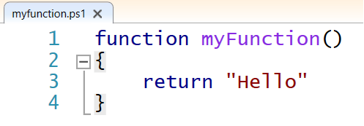
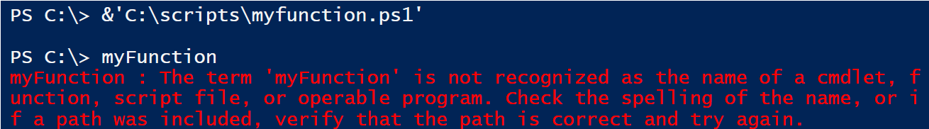
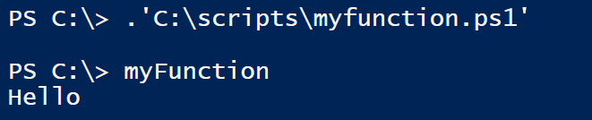
Examples
Run the script with &:
Dot source the script with . :

Slide 43

Summing up
In this presentation we talked about writing scripts
This was the part most like programming
PowerShell is actually a pretty powerful programming language
It didn’t contain any new cmdlets, but did show how to tie together the existing cmdlets
You just crossed the line between a oneliner with to many pipes to a real script

